Slide 1

UNIVERSITY OF RWANDA
COLLEGE OF SCIENCE AND TECHNOLOGY
Y3 CSE
Group 4: TransConnect
  Members: MUSAZA PATRICK (223019061)
  MANZI NSENGA IVAN (223004392)
Module: Computing Intelligence & Applications
Date: 27th November 2025

Slide 2



Cont…
Selected Models for TransConnect
3. Gradient Boosting Regression – Ensemble model of many decision trees
4. Decision Tree – supervised non‑linear model
CASE STUDY
ROUTE
Kabuga - Nyabugogo

Slide 3





Advantages:
  High prediction accuracy
  Handles complex relationships
  Great for time‑based forecasting
Gradient Boosting – What Was Completed
Disadvantages:
  Slower training
  Sensitive to hyperparameters
  Can overfit if not tuned
Learns sequentially: each tree corrects previous errors
Very powerful for structured data
Key Features:
Simple, Fast, and Computationally Efficient
Highly Interpretable
Works Well on Linearly Related Data (travel time, distance, time of day, road features)

Slide 4

Code Snippet
Import Libraries
Set Model
import pandas as pd
import numpy as np
import matplotlib.pyplot as plt
from sklearn.model_selection import train_test_split
from sklearn.ensemble import GradientBoostingRegressor
from sklearn.metrics import mean_absolute_error, mean_squared_error, r2_score
def __init__(self):
self.model = LinearRegression()
self.results = {}
self.scaler = StandardScaler()
Train Dataset
Performance Metric
X_train, X_test, y_train, y_test = train_test_split(X, y, test_size=0.2, random_state=42)
X_train_scaled = self.scaler.fit_transform(X_train)
X_test_scaled = self.scaler.transform(X_test)
self.model.fit(X_train_scaled, y_train)
y_pred = self.model.predict(X_test_scaled)
mae = mean_absolute_error(y_test, y_pred)
mse = mean_squared_error(y_test, y_pred)
rmse = np.sqrt(mse)
r2 = r2_score(y_test, y_pred)
Date: 11th September 2025

Slide 5
VISUALIZATION

Slide 6
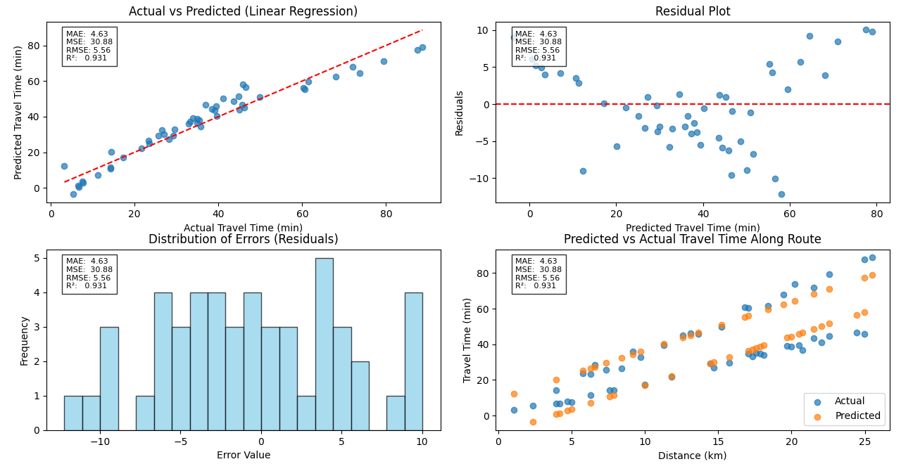

Slide 7
Random Forest – What Was Completed
Handles non‑linear transit patterns well
Key Features:
Advantages: high accuracy, robust
Features do not need normalization or standardization (unlike Linear Regression)
Disadvantages: slower, harder to interpret
Provides Feature Importance
High Accuracy on Tabular Data

Slide 8
CODE SNIPPET
Library
Model Fitting
import pandas as pd
import numpy as np
import matplotlib.pyplot as plt
import seaborn as sns
from sklearn.model_selection import train_test_split
from sklearn.ensemble import RandomForestRegressor
from sklearn.metrics import mean_absolute_error, mean_squared_error, r2_score
from sklearn.preprocessing import StandardScaler
def __init__(self):
self.model = RandomForestRegressor(
n_estimators=150,
random_state=42,
n_jobs=-1
)
self.results = {}
Train Model
Performance Metric
X_train, X_test, y_train, y_test = train_test_split(
X, y, test_size=0.2, random_state=42
)
self.model.fit(X_train, y_train)
y_pred = self.model.predict(X_test)
mae = mean_absolute_error(y_test, y_pred)
mse = mean_squared_error(y_test, y_pred)
rmse = np.sqrt(mse)
r2 = r2_score(y_test, y_pred)

Slide 9
VISUALIZATION

Slide 10
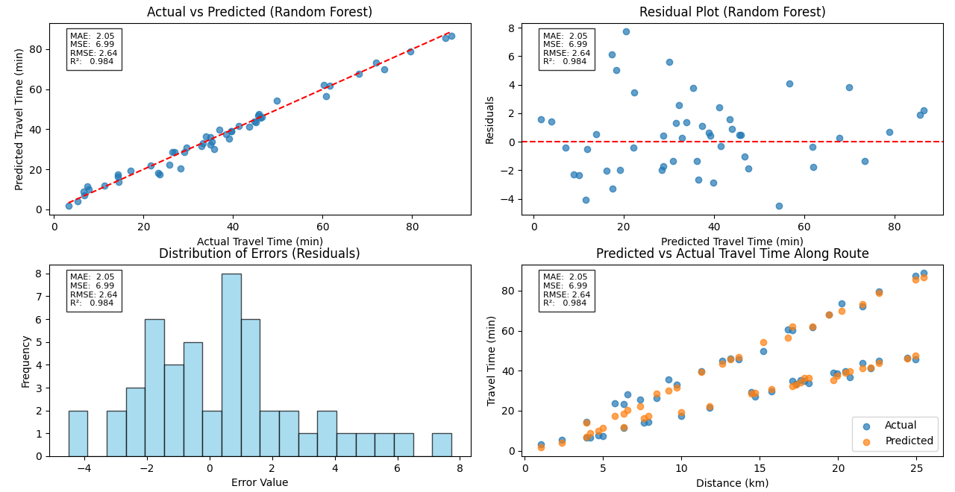

Slide 11
LINEAR REGRESSION VS RANDOM FOREST

Slide 12
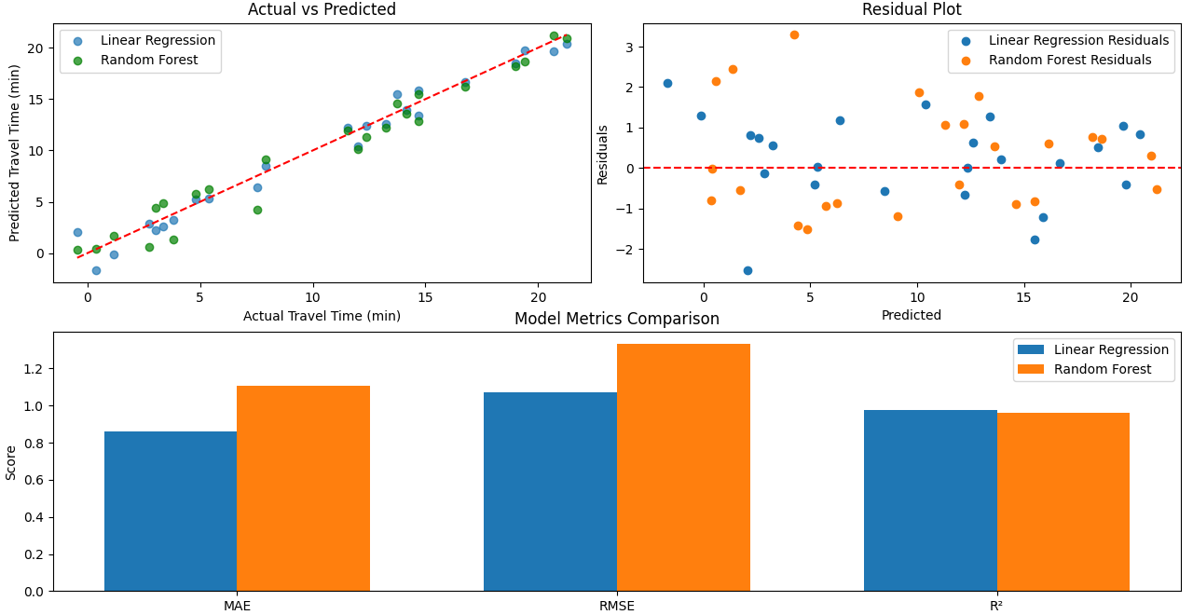

Slide 13
What Will Be Completed Next Week
Add true arrival-time labels (not synthetic, if possible)
Train additional models (GradientBoostingRegressor, Decision Tree)
Build prediction API for TransConnect web‑app
Deploy best model for real-time ETA

Slide 14
Challenges
Limited historical data
GPS noise and inconsistent‑format coordinates
Few features available for prediction
Hard to validate ETA accuracy in real time

Slide 15




Mitigation Measures
Collect more real bus timing logs (according to passengers, like us)
Apply smoothing & cleaning to GPS streams
Add engineered features (traffic, rush hour, holidays)
Test across multiple routes for reliability

Slide 16
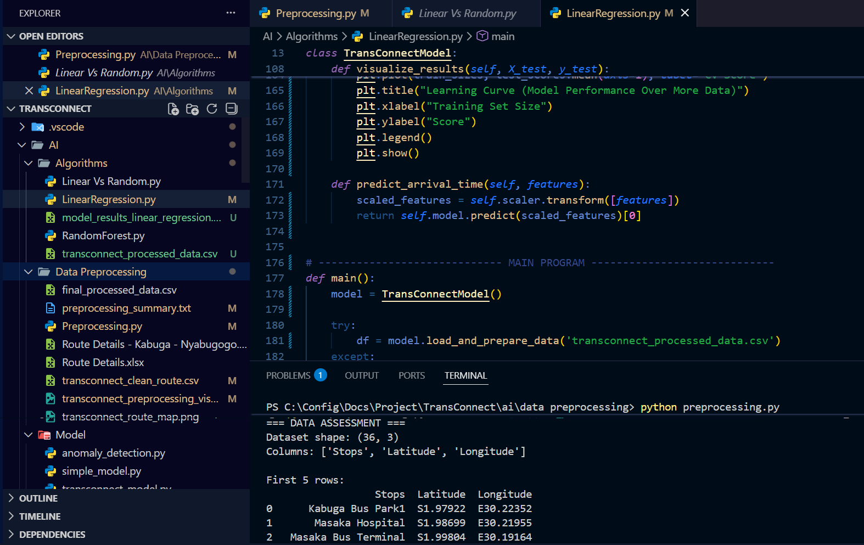
LINEAR REGRESSION – FULL SOURCE CODE
Linear Model

Slide 17
RANDOM FOREST– FULL SOURCE CODE
Random Model

Slide 18
END

